Slide 1
SSW-555: Agile Methods for Software Development
Agile Cultures
Use Cases and User Stories
Prof. Jim Rowland
Software Engineering
School of Systems and Enterprises

Slide 2
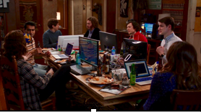
Today’s topics
Goal: Compare organizations and cultures in Plan Driven and Agile organizations
Compare roles of developers, managers, and executives
Acknowledgement: Introduction to Agile Methods, Ashmore and Runyan, 2015.
“Office Space”
“HBO Silicon Valley”

Slide 3
Corporate Culture
Plan Driven Cultures | Agile Cultures
Managers assign teams | Self organizing teams
Individuals work for the manager | Individuals work for the team
Individuals measured on individual achievements | Individuals measured on team achievements
Manager assigns tasks | Team members select tasks
Manager responsible for improvement | Team responsible for reflection and continuous improvement
Infrequent deliveries | Frequent/continuous deliveries
Infrequent feedback from customers | Frequent/continuous feedback from customers
“Us and them” e.g. testing, Ops | ”Us” e.g. testing, Ops

Slide 4
What can go wrong with the team?
Dysfunctional teams
Fail to self organize
“Tell me what to do…”
Hostility to members
“That’s not my job…”
Inability to adapt to change
Losing private offices is hard
Lacking commitment

Slide 5
Role of managers
Plan Driven Cultures | Agile Cultures
Define solutions to be implemented by the team | Asking questions while allowing the team to create the solution
Define roles and responsibilities | Help team to self organize
Leading the effort | Enabling the team while clearing roadblocks to success
Command and Control of the team | Trusting the team
Manager owns the problem | Team owns the problem

Slide 6
Role of executives
Plan Driven Cultures | Agile Cultures
Clear, unchanging direction defined early in the process | Embrace changes
Manage by business case | Rapid delivery and inspection
Attempt to understand entire problem and outcome in advance | Quick prototype solutions to understand impact
Where would you rather work?

Slide 7
Agile doesn’t work for everyone…
Not all teams successfully transition to Agile Methods
Failure may be attributed to:
Lack of clarity across the team
Using only the worst of Waterfall and Agile together:
Forcing frequent short deliverables without the Agile advantages
Inadequate training or support for Agile Methods
Yesterday: product manager; today: scrum master
Failing to use automated testing and/or continuous integration
Continuing to plan everything in advance and not allowing change
Failing to change employee performance metrics
Failing to inspect and adapt – Andy Hunt

Slide 8
Conclusions

Slide 9
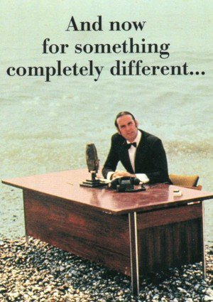

Slide 10
Gathering requirements
Goal: Gather features and requirements for a new system
Compare and contrast three different approaches
Traditional Requirements - Plan Driven method requirements
Use Cases – RUP approach for capturing requirements
User Stories – agile approach for capturing requirements
Beware: Use Cases and User Stories may be a contentious issue!
“A user story is to a use case as a gazelle is to a gazebo” – Alistair Cockburn
http://alistair.cockburn.us/A+user+story+is+to+a+use+case+as+a+gazelle+is+to+a+gazebo

Slide 11
Plan driven requirements
Gathering requirements is typically the first step in a plan driven SDLC
Business Analyst interviews the customer to extract features required from the system
The system shall allow the user to enter her name, address, and email
The system shall be available 24x7x365 with 0.99% reliability
Business Requirements Document (BRD)
Formal contract between the customer and the team delivering the product
https://upload.wikimedia.org/wikipedia/commons/thumb/e/e2/Waterfall_model.svg/1280px-Waterfall_model.svg.png

Slide 12
Business Requirements Document (BRD)
All requirements are gathered and reviewed by the business analysts before handing over to development
Little or no discussion between customers and developers
Describes all of the features needed by the customer
Functional requirements, e.g. features
Non-functional requires, e.g. availability, …
Limitations
Assumption of completeness
Difficult to change
Not created by developers and thrown over the wall to the developers
https://upload.wikimedia.org/wikipedia/commons/thumb/e/e2/Waterfall_model.svg/1280px-Waterfall_model.svg.png

Slide 13
Example domain
MSS: Music Streaming System
Spotify, Apple Music, Pandora, …
Users choose music to stream to their phone, laptop, or device
Web based solution

Slide 14
Use cases
Developed by Ivar Jacobson in 1980s for OO based methods
Part of UML and RUP (Rational Unified Process)
Each use case describes:
A scenario
The actors in the scenario
Actors may be people or systems
A sequence of actions between the actor and the system
An observable result of value to a particular actor
Actor’s intention/what does the actor want?

Slide 15
Use case method
Identify the actors
Identify the use cases
Identify actor/use case relationships
Outline scenarios

Slide 16
1. Identify the actors
Who uses the system?
Who gets information from the system?
Who provides information to the system?
Who supports the system?
What other systems interact with this system?
Remember that actors may be other systems
MSS Example:
- Users, marketing, content owners, streaming servers, …

Slide 17
2. Identify the use cases
What are the intentions of each actor with respect to the system?
Give a descriptive name
Start with an action verb
Describe the goal or intent
Give a one-sentence description

Slide 18
2. MSS: Identify the use cases
Use Case: Play song– user plays a song on device
The user should be able to play a song on her device and control playback with start, stop, pause, forward, back
Use Case: Explore music – user explores available music
The user should be able to explore different music alternatives that can be played on the device
Use Case: Collect user profile – gather information about the user
The system should collect demographic information from users

Slide 19
3. Identify Actor/Use Case Relationships in a Use Case Diagram
Draw a diagram showing relationships between actors and use cases
Play Song
Explore Music
User
System
Collect User Profile

Slide 20
4. Outline Scenarios
Describe sequence of events in basic flow (sunny day scenario)
Describe sequences of events in alternate flows (rainy day scenarios)
Play Music:
Basic Flow: User selects song and plays song from beginning to end
Alternate Flow: User selects song but song is not available for playing
Alternate Flow: User fast forwards through first 30 seconds

Slide 21
Use case template
Name
Brief description
Actors
Basic flow
Alternate flows

Slide 22
MSS play song example
Play song
User

Slide 23
Play song use case 1 of 3
Name: Play song
Brief description: The user selects a song from MSS and plays the song
Actors: User

Slide 24
Play song use case 2 of 3
Basic flow:
User visits MSS home page
User selects a song from available content
User pushes start button
Song is streamed to the user’s device
Song plays on user’s device

Slide 25
Play song use case 3 of 3
Alternate flows
User selects song but doesn’t start playing
Song selected by user selected is not available for streaming
User fast forwards past first 30 seconds of song

Slide 26
Use Case Summary
Use cases describe the scenarios in terms of actors and actions
Specify “all possible” scenarios
Typically include detailed instructions on how to accomplish those scenarios

Slide 27
User Stories: Agile Approach
Customers communicate their needs via short statements
Customers provide the user stories with help from developers
Each User Story is a reminder for the customer and developer to discuss the issue
Each statement describes the goal of an actor
"as a user I want to ..."
Customer should decide priority of each user story
MSS Play song:
As a user I want to be able to play a song so I can listen to it from beginning to end so I can hear the song
Priority 1

Slide 28
3 C’s of User Stories
C
The Card
C
Conversation
C
Confirmation
User stories are frequently written on 3x5 cards
A user story is a promise of a conversation between the customer and developers
Each user story includes tests to confirm that the feature has been delivered

Slide 29
Developers help to elaborate user stories
Sometimes user stories need elaboration to explain exactly what is needed
Customer and developers resolve any ambiguities
A developer estimates the effort required for each user story
MSS Play Song:
Effort: 2 story points

Slide 30
User story components
Title – a short handle for the story. Present tense verb in active voice is desirable
Acceptance test –the name of a method to test the story
How to determine if the functionality is provided?
Acceptance test helps to flesh out the details of the user story
Priority – decided by the customer
Story points – estimated time to implement expressed in relative units
Description – one to three sentences describing the story

Slide 31
Criteria for User Stories
Each story should add value to the customer
Customers write user stories (with help from developers if needed)
Stories need to be small enough that several can be completed per iteration
Replace big stories with several smaller stories
Stories should be independent (as much as possible)
Stories must be testable – like any requirement, if it cannot be tested, it’s not a requirement!
Include non-functional requirements as User Stories

Slide 32
INVEST in User Stories (Bill Wake)
I
Independent in context and scheduling
N
Negotiable between customer and developers
V
Valuable to the customer
E
S
Estimable value to customer & effort for developers
T
Small in scope
Testable: include sufficient detail to allow testing
http://xp123.com/articles/invest-in-good-stories-and-smart-tasks/

Slide 33
User story layout
Front
Back
Title
Elaboration of the User Story
With additional details
AcceptanceTest
Priority
Story Points
Description
3x5 index card

Slide 34
User story: play song
Title: Play song
Acceptance Test: playSong
Priority: 1
Story Points:2
As a user I want play a song
so that I can hear the song from beginning to end
1= high priority, 2 story points = 2 days

Slide 35
Estimating time for user stories
Developers estimate how long each story will take
Estimates are expressed in Story Points
Relative measure of effort
Task₁ requires twice as much effort as Task₂
e.g. developers can deliver 3 story points per day
But, how do they know how long a new story will take?
previous experience
similar stories on project
use a consensus process to compare estimates

Slide 36
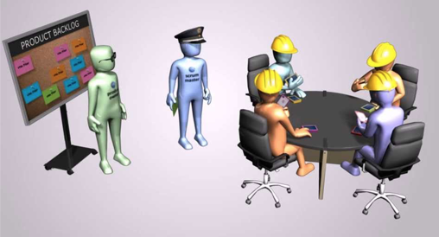
Planning poker
Goal: estimate relative effort for each user story
Participants:
Developers estimate effort
Scrum Master optimizes the process
Product owner answers questions
Process:
For each user story:
Describe the user story
Each developer assigns effort
Continue until consensus
https://www.youtube.com/watch?v=UJ-NnDficnE

Slide 37
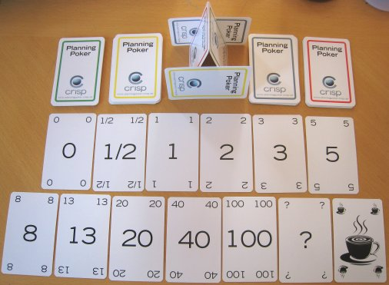
Planning poker
Consensus process similar to Wideband Delphi (Boehm)
Each expert provides an estimate simultaneously
All estimates are shared, perhaps with explanations
Continue until consensus reached
Planning Poker uses special playing cards to simplify estimating, and to encourage reasonable estimates

Slide 38
Limitations of User Stories
User Stories come from XP
Small teams with engaged customers
What can go wrong?
Lack of look-ahead
Lack of context
Lack of completeness
Source: http://proquest.safaribooksonline.com/book/software-engineering-and-development/agile-development/0321482751

Slide 39
User Story Limits and Solutions
Lack of look-ahead
Developers need quick responses from customers
What if the appropriate customer isn’t available when needed?
Anticipate that the answers may not be readily available
Developers need to plan far enough ahead to allow time for answers
Source: http://proquest.safaribooksonline.com/book/software-engineering-and-development/agile-development/0321482751

Slide 40
User Story Limits and Solutions
Lack of context
User Stories are expressed in simple, concise statements
What if the statement is terse/too concise?
Group together related User Stories
Provide relevant context
Source: http://proquest.safaribooksonline.com/book/software-engineering-and-development/agile-development/0321482751

Slide 41
User Story Limits and Solutions
Lack of completeness
Gaps may arise as the user stories and product evolve
Continue to add User Stories as the project evolves
Source: http://proquest.safaribooksonline.com/book/software-engineering-and-development/agile-development/0321482751

Slide 42
When to use which?
User Stories are more flexible and easier to write
Ideal for small projects:
where a dedicated customer responds to questions
where a small team can deliver the entire solution
Use Cases are more rigorous
May be better for larger projects
Where risks are higher
Source: http://proquest.safaribooksonline.com/book/software-engineering-and-development/agile-development/0321482751

Slide 43

Questions?

